Slide 1




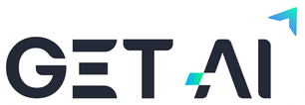


DATA SATURDAY
MELBOURNE 2025
Presented by:
Date: 11th October 2025

Slide 2
Data Governance
An Introduction
Presented by:
Date: 11th October 2025

Slide 3

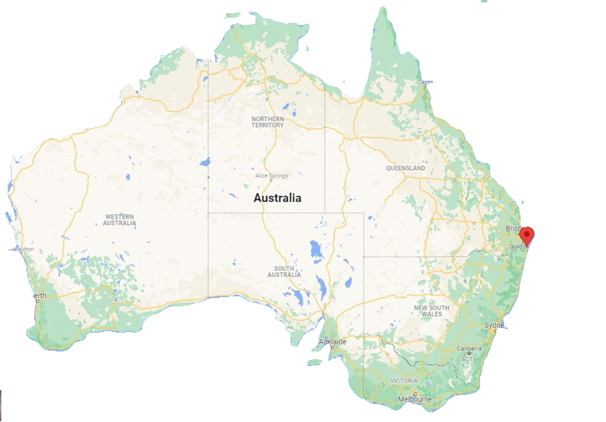

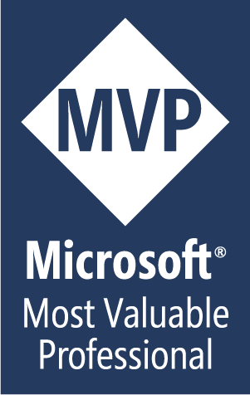
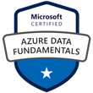
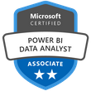



Martin Catherall
Data Architect
Manager – Data Engineering.
Avanade, Brisbane, Australia
SQL Server
Since 2002
Microsoft Azure
Since 2015
Microsoft Fabric
Since 2022
/in/martincatherall/

Slide 4

Slides
https://tinyurl.com/aezw96xf

Slide 5
AGENDA
Introduction
The pillars of Governance
Components of Data Governance
Drilling into Data Governance Ingredients
Roles
Tooling
Resources
Summary

Slide 6
Introduction

Slide 7
What is ‘Data Governance?’
Data governance is a set of principles and practices that ensure high quality through the complete lifecycle of your data.
What gets measured gets managed
The human side of analytics is the biggest challenge to implementing big data.

Slide 8
Differing needs – Differing views
Strategic View: Data governance is the exercise of authority and control over the management of data assets, ensuring data is treated as a valuable business asset that supports organizational objectives.
Operational View: It's the system of decision rights and accountabilities for data-related processes, executed according to agreed-upon models that describe who can take what actions with what data, when, under what circumstances, and using what methods.
Quality-Focused View: Data governance is the practice of managing data availability, usability, integrity, and security in an organization, ensuring data is accurate, consistent, and trustworthy for decision-making.
Compliance-Oriented View: It's the collection of practices and processes that help ensure the formal management of data assets within an organization, with particular emphasis on meeting regulatory requirements and managing data-related risks.
Notes:
Compliance includes security.

Slide 9
The pillars of Governance

Slide 10
Governance
Fairness
Accountability
Transparency
Responsibility
The Pillars of Governance
Notes:
Similar to a RACI (Responsible | Accountable | Consulted | Informed).

Slide 11
Fairness in Data Governance
Fairness in data governance refers to ensuring that data collection, processing, and use don't perpetuate discrimination or create unjust outcomes for individuals or groups. It's a critical principle that addresses how data-driven decisions impact different populations.
Bias Prevention: Data governance frameworks must identify and mitigate biases in datasets that could lead to unfair treatment based on protected characteristics like race, gender, age, or socioeconomic status. This includes examining historical biases embedded in training data.
Equitable Access: Fair data governance ensures that the benefits of data use are distributed equitably, and that certain groups aren't systematically excluded from services or opportunities based on algorithmic decisions.
Representation: Datasets should adequately represent diverse populations to avoid creating systems that work well for some groups but poorly for others. Underrepresented groups in data can face worse outcomes from automated systems.
Accountability: Organizations must establish clear processes for auditing algorithms and data practices for fairness, and provide mechanisms for people to challenge unfair decisions or outcomes.
Transparency: Fairness requires transparency about how data is used to make decisions that affect people's lives, enabling scrutiny and accountability.
In practice, fairness in data governance means implementing policies, technical controls, and oversight mechanisms that actively work to prevent discriminatory outcomes while promoting equitable treatment across all affected populations.

Slide 12
Accountability in Data Governance
Accountability in data governance refers to establishing clear responsibility and ownership for data-related decisions, actions, and outcomes throughout an organization. It ensures that individuals and teams can be held answerable for how data is managed, used, and protected.
Clear Ownership: Accountability requires defining specific roles and responsibilities for data stewardship, quality, security, and compliance. This includes designating data owners, custodians, and users who are responsible for different aspects of data management.
Documented Policies: Organizations must maintain clear, documented policies and procedures that define acceptable data practices, decision-making authority, and expected standards of behavior. These policies provide the framework against which accountability is measured.
Audit Trails: Maintaining comprehensive logs and records of data access, modifications, and decisions enables organizations to trace actions back to responsible individuals. This transparency is essential for both compliance and identifying issues.
Consequences and Enforcement: True accountability requires mechanisms to enforce policies, including consequences for violations and rewards for compliance. Without enforcement, accountability frameworks remain theoretical.
Regulatory Compliance: Accountability extends to meeting legal and regulatory obligations, such as data protection laws (GDPR, CCPA), with designated individuals responsible for ensuring compliance.
Stakeholder Communication: Accountable organizations maintain open channels for reporting concerns, responding to data incidents, and communicating with stakeholders about data practices and breaches.
In practice, accountability transforms data governance from abstract principles into actionable responsibilities, ensuring that someone is always answerable for data-related outcomes.

Slide 13
Transparency in Data Governance
Transparency in data governance refers to the practice of making data policies, processes, and practices visible and understandable to stakeholders. It ensures that people can see and comprehend how data is collected, used, shared, and protected within an organization.
Clear Communication: Transparency requires organizations to communicate their data practices in plain language that non-technical stakeholders can understand. This includes privacy policies, terms of service, and data usage notices that are accessible rather than buried in legal jargon.
Data Processing Visibility: Organizations should disclose what data they collect, why they collect it, how long they retain it, and who has access to it. This extends to third-party data sharing and the purposes for which data is used.
Algorithmic Transparency: When automated systems make decisions affecting people, transparency means explaining how these algorithms work, what data they use, and the logic behind their decisions. This is particularly important for AI and machine learning systems.
Access Rights: Transparent data governance provides individuals with the ability to access their own data, understand what information is held about them, and see how it has been used or shared.
Reporting and Disclosure: Regular reporting on data incidents, breaches, governance metrics, and compliance status demonstrates organizational commitment to transparency and builds stakeholder trust.
Documentation: Maintaining accessible documentation of data lineage, metadata, data dictionaries, and governance processes ensures that internal teams and external auditors can understand data flows and practices.
In practice, transparency builds trust, enables informed consent, supports compliance, and empowers individuals to exercise their data rights while holding organizations accountable for their data stewardship.

Slide 14
Responsibility in Data Governance
Responsibility in data governance refers to the ethical and operational duty organizations and individuals have to manage data properly, protect stakeholder interests, and ensure data practices align with organizational values and societal expectations. It encompasses the broader obligation to act as trustworthy stewards of data.
Ethical Data Stewardship: Responsibility means treating data as a valuable asset that must be handled with care, respecting the rights and interests of data subjects. Organizations have a duty to use data in ways that benefit stakeholders without causing harm.
Proactive Risk Management: Responsible data governance involves anticipating and mitigating risks related to data security, privacy breaches, misuse, and unintended consequences. This includes implementing appropriate safeguards before problems occur.
Data Quality and Integrity: Organizations are responsible for ensuring data accuracy, completeness, and reliability. Poor data quality can lead to flawed decisions that harm individuals and undermine trust.
Lifecycle Management: Responsibility extends across the entire data lifecycle—from collection through retention to secure disposal. This includes minimizing data collection to what's necessary and deleting data when no longer needed.
Stakeholder Protection: Organizations must prioritize the protection of vulnerable populations, respect privacy rights, maintain confidentiality, and ensure data security against unauthorized access or breaches.
Organizational Culture: Responsibility requires cultivating a culture where everyone understands their role in data governance and feels empowered to raise concerns, report issues, and prioritize ethical data practices.
Continuous Improvement: Responsible organizations regularly review and update their data governance practices to address emerging risks, new regulations, and evolving best practices.
In practice, responsibility means organizations don't just comply with minimum legal requirements but actively work to be trustworthy custodians of data, considering the broader impact of their data practices on individuals and society.

Slide 15
Components of Data Governance

Slide 16
Mitigate
Assess
Risk
Management
Review
Monitor
Control
Identify

Slide 17
Identify Risks
Data breaches and unauthorized access – Sensitive information exposed due to inadequate security controls or access management
Compliance violations – Failing to meet regulatory requirements (GDPR, HIPAA, etc.) resulting in fines and legal consequences
Poor data quality – Inaccurate, incomplete, or inconsistent data leading to flawed decision-making and business impacts
Lack of accountability – Unclear data ownership and responsibilities causing gaps in oversight and management
Shadow IT and ungoverned data – Employees creating uncontrolled data stores outside official systems, creating security and compliance risks
Inadequate documentation – Missing or poor metadata and data lineage making it difficult to understand data origins and transformations
Insufficient change management – Data governance policies not keeping pace with business changes, new technologies, or evolving regulations
Limited stakeholder buy-in – Resistance to governance processes leading to poor adoption and inconsistent implementation

Slide 18
Assess - Risk Assessment Framework:
Likelihood and Impact Analysis – Rate each risk on probability of occurrence (low/medium/high) and potential business impact (financial, reputational, operational). Plot on a risk matrix to prioritize attention.
Regulatory and Compliance Exposure – Evaluate which risks could trigger regulatory penalties, considering specific laws applicable to your industry and geography. Calculate potential fines and legal costs.
Data Sensitivity Classification – Assess risks based on the sensitivity of data involved (public, internal, confidential, restricted). Higher sensitivity data carries greater risk weight.
Current Control Effectiveness – Review existing safeguards and controls for each risk. Identify gaps between current state and desired security posture.
Business Impact Assessment – Quantify potential costs including direct financial losses, productivity impacts, customer churn, and brand damage for each risk scenario.
Threat Landscape Review – Consider external factors like emerging cyber threats, industry trends, and past incidents in your sector to contextualize risk levels.

Slide 19
Mitigate
Secure executive sponsorship and visible leadership support
Implement role-based access controls (RBAC) and principle of least privilege
Establish a compliance management framework mapping regulations to controls
Define and enforce data quality standards and validation rules
Define clear data ownership with assigned data owners and stewards
Implement discovery tools to identify unauthorized data repositories
Implement a metadata management system or data catalog
Create and enforce documentation standards
Monitor regulatory changes and assess impacts
Implement a risk-based approach, focusing resources on highest-priority areas

Slide 20
Review
Review Planning and Preparation:
Define review scope, objectives, and timeframe
Document and Policy Review:
Control Testing and Validation:
Compliance Assessment:
Stakeholder Interviews and Surveys:
Metrics and KPI Analysis:
Gap Analysis:
Technology and Tool Assessment:

Slide 21
Monitor
Real-Time Automated Monitoring:
Deploy data activity monitoring tools to track access, modifications, and transfers in real-time
Regularly review user access rights against role requirements
Establish automated data profiling to detect quality issues (completeness, accuracy, consistency)
Track data retention and deletion schedules for adherence
Use data lineage tools to monitor how data flows through systems
Monitor adherence to data handling procedures and standards
Maintain a centralized incident log capturing all data-related events
Monitor metadata completeness and accuracy in data catalogs
User Behavior Analytics:

Slide 22
Control
Control Framework and Governance Structure:
Segregation of Duties:
Establish a formal governance framework defining control objectives, policies, and standards
Implement role-based access control (RBAC) with segregation of duties
Change and Configuration Management Controls:
Access Controls:
Technical Controls:
Training and Awareness Controls:
Data Quality Controls:
Process and Procedural Controls:
Classification and Labeling Controls:
Monitoring and Detective Controls:
Preventive Controls:
Third-Party and Vendor Controls:

Slide 23
Drilling into Data Governance Ingredients

Slide 24
Company Performance
Business
Outcomes
Decision Quality
Information Quality
Data Quality

Slide 25
The pieces
Harmony
People
Business
Technology

Slide 26
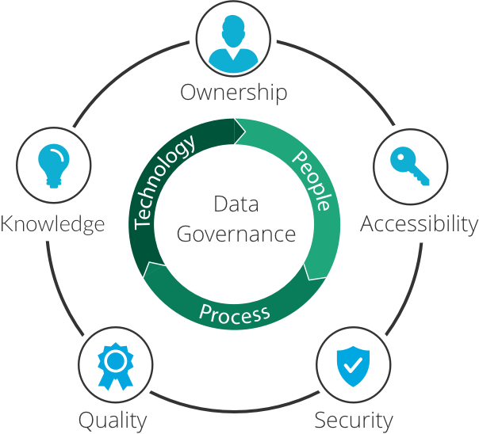

Slide 27
Validity
Complete
Accuracy
Data
Quality
Timely
Consistency
Integrity

Slide 28
Roles

Slide 29
Data Governance Roles
Chief Data Officer (CDO)
Chief Information Officer (CIO)
Chief Privacy Officer (CPO)
Chief Information Security Officer (CISO)
Data Governance Council/Steering Committee
Data Owner
Data Steward
Business Data Steward
Technical Data Steward
Subject Matter Expert (SME)

Slide 30
Tooling

Slide 31
Data governance Tool Types
Enterprise Data Governance Platforms:
Data Cataloging and Metadata Management:
Data Quality Tools:
Master Data Management (MDM):
Data Lineage and Impact Analysis:
Privacy and Compliance Management:

Slide 32
Data governance Tools
Microsoft Purview
Enterprise Data Governance
Collibra
Enterprise Data Governance
Informatica Axon
Enterprise Data Governance
Alation
Enterprise Data Governance
Informatica Data Quality
Data Quality
Talend Data Quality
Data Quality
Informatica MDM
Master Data Management (MDM)
SAP Master Data Governance
Master Data Management (MDM)
Profisee
Master Data Management (MDM)
Collibra Lineage
Data Lineage

Slide 33
Resources

Slide 34
Responsible AI
Fairness
AI systems should treat all people fairly. How might an AI system allocate opportunities, resources, and information in ways that are fair to the humans who use it?
Inclusiveness
AI systems should empower everyone and engage all people, regardless of their backgrounds.
How might a system be designed to be inclusive for people of all abilities?
Reliability and safety
AI systems should perform reliably and safely. How might a system function well for people across different use conditions and contexts, including ones that it wasn’t originally intended for?
Privacy and security
AI systems should be secure and respect privacy. How might a system be designed to support privacy and security?
Accountability
People should be accountable for AI systems.
How can we create oversight so that humans can be accountable and in control?
Transparency
AI systems should be understandable. How can we ensure that people correctly understand the capabilities of a system?
Responsible AI Principles and Approach | Microsoft AI

Slide 35
Data Privacy Regulations
Jurisdiction dependant
Geo Political
European Union
GDPR (General Data Protection Regulation)
Country / Federal
HIPAA (Health Insurance Portability and Accountability Act)
State
CCPA/CPRA (California Consumer Privacy Act / California Privacy Rights Act)
Local
Health Records Act 2001 (Victoria)
Organisational
Internal restrictions – eg Restricted / Confidential / Public
Industry Specific
PCI DSS (Payment Card Industry Data Security Standard)
SOX (Sarbanes-Oxley Act)
FISMA (Federal Information Security Management Act)
Notes:
Mostly Jurisdiction dependant
Regulatory bodies are set up for most industries – eg Finance , Health

Slide 36
Australian Privacy Principles (APPs)
APP 1 - Open and transparent management of personal information
APP 2 - Anonymity and pseudonymity
APP 3 - Collection of solicited personal information
APP 4 - Dealing with unsolicited personal information
APP 5 - Notification of the collection of personal information
APP 6 - Use or disclosure of personal information
APP 7 - Direct marketing
APP 8 - Cross-border disclosure of personal information
APP 9 - Adoption, use or disclosure of government related identifiers
APP 10 - Quality of personal information
APP 11 - Security of personal information
APP 12 - Access to personal information
APP 13 - Correction of personal information

Slide 37
Resources
Learn about Microsoft Purview | Microsoft Learn
Responsible AI Principles and Approach | Microsoft AI
General Data Protection Regulation (GDPR) – Legal Text
Australian Privacy Principles | OAIC
Home - DAMA International®
DAMA Australia
What is governance? - Governance Institute of Australia
Data Governance Principles and Practices - AUSCERT
Home | Data Governance Australia
Unified governance for data and AI | Collibra
What is Unity Catalog? | Databricks on AWS

Slide 38
Resources
Data Governance Literacy Path | Pluralsight
data governance: Online Courses, Training and Tutorials | LinkedIn Learning

Slide 39


Slide 40

Presented by:
THANK YOU FOR YOUR ATTENTION
Slides
Please leave a review!
https://tinyurl.com/aezw96xf

